Slide 1


Junction — Events for Students and Professionals
College Project Presentation
KL University | Project Presentation

Slide 2

Project Presentation By
Team No.: [Add team number]
BATCH MEMBERS:
D. SAI BHASKAR—Roll No. 2520090098
GUIDED BY: Khaja Shareef

Slide 3




Introduction
What is it?
What does it include?
How does it work?
Junction is a centralized platform for discovering and booking curated events for students and professionals.
Workshops, networking mixers, hackathons, career fairs, webinars, and conferences in one clear experience.
Users explore an event, choose a batch or speaker, and receive an instant e-ticket.

Slide 4
Problem Statement
Scattered Discovery
Students and early-career professionals discover opportunities across scattered channels.
Hard to Compare
Event information, seat availability, speakers, pricing, and booking details are not always easy to compare.
Attendance Uncertainty
Manual coordination creates uncertainty between interest, registration, and attendance.
One Organized Catalog
Junction brings event opportunities into one organized discovery experience.
Clear Event Details
Users can review availability, speakers, pricing, and booking details in one flow.
Junction’s Response
Junction addresses this gap with one organized
discovery and booking flow.

Slide 5
Objectives
01
Centralize Event Discovery
Bring workshops, networking, hackathons, career fairs, webinars, and conferences into one place.
02
Make Decisions Easier
Show live availability, batches, speakers, tracks, and pricing before booking.
03
Reduce Booking Friction
Move from selection to confirmation in a few clear steps.
04
Support Career Growth
Connect users with mentors, speakers, and relevant communities.
05
One Clear Experience
Keep event categories, choices, and booking information easy to navigate.
06
Relevant Communities
Help students and professionals find events aligned with their interests and goals.

Slide 6
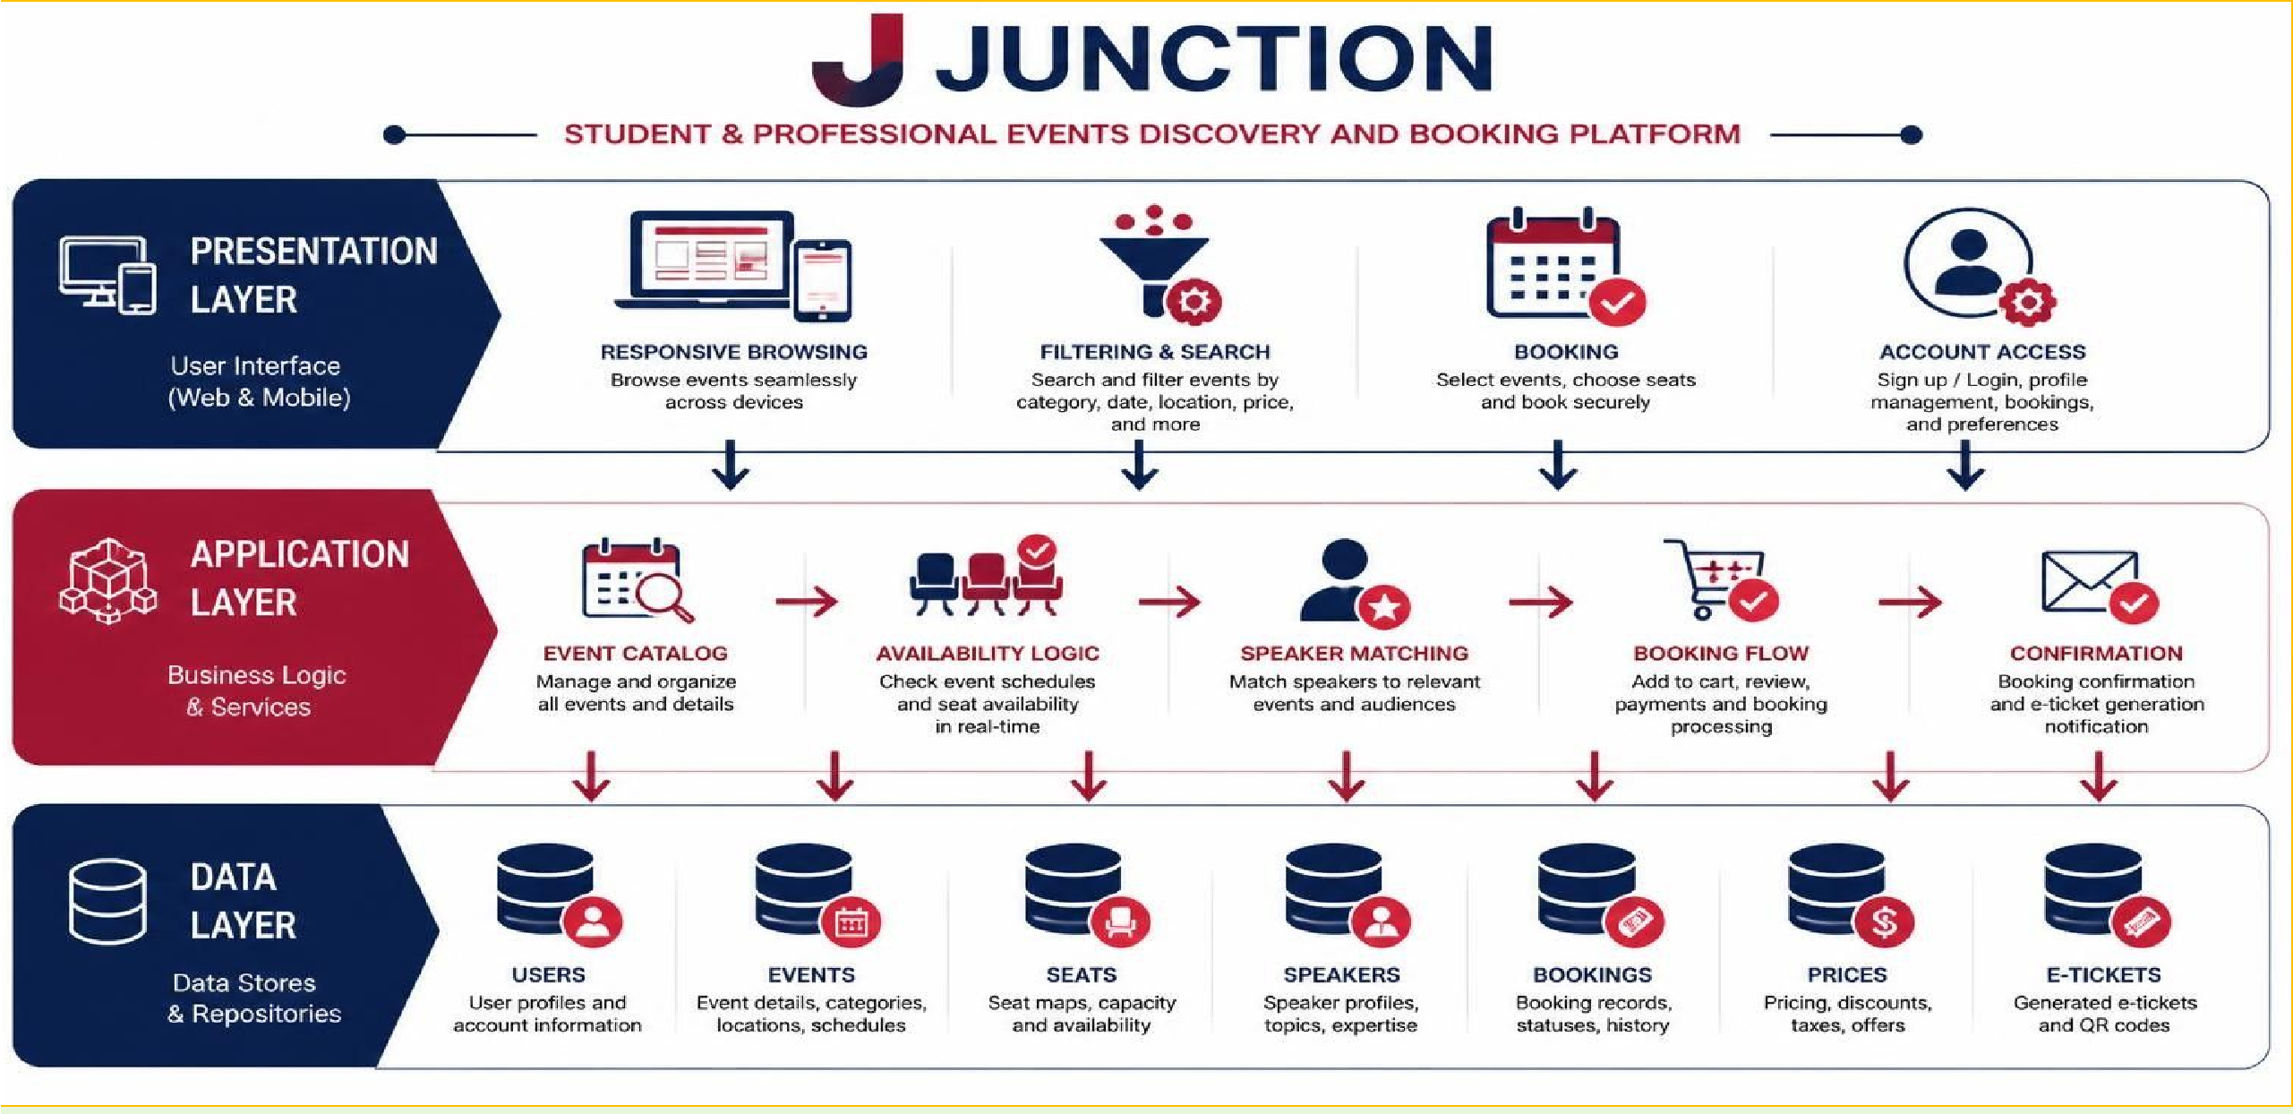
System Architecture

Slide 7








Key Features
Role-Based Experience
Account access for attendees and platform operations.
Event Discovery
Filter workshops, networking, hackathons, career fairs, webinars, and conferences.
Live Seat Picker
See dates, time slots, seat status, and price before booking.
Speaker & Track
Choose the right mentor or event path.
Booking Dashboard
Instant E-Ticket
Receive confirmation after selecting an event, batch, or speaker.
Curated Events
Explore organized opportunities for students and professionals.
Clear Booking Flow
Move from event discovery to confirmed attendance in a few clear steps.
Keep upcoming and past bookings in one place.

Slide 8





Technology Stack
React.js
Frontend
Node.js
Runtime
Express.js
Backend Framework
MongoDB
Database
React component-based UI, React Router, Axios, Context API / Redux.
Server-side JavaScript runtime for backend logic and APIs.
RESTful API endpoints with middleware for auth, validation, and error handling.
NoSQL document store for flexible schemas.
Supporting Technologies
JWT Authentication, bcrypt, Multer (file uploads), Nodemailer / Twilio, Razorpay SDK, Chart.js, Tailwind CSS / Bootstrap, Git & GitHub.

Slide 9
Conclusion & Future Scope
Conclusion
Junction provides one organized path from discovering an opportunity to reserving a seat and showing up ready.
Future Scope
Organizer Dashboards
Payments
Reminders
Personalized Recommendations
Personalize
recommendations and
expand across campuses, cities, and professional communities.
Give organizers tools to manage events, speakers, availability, and bookings.
Support secure payment steps for eligible event bookings.
Add reminders, reviews, and analytics to strengthen the event experience.

Slide 10

Thank You
Questions & Discussion
KL University | Junction — Events for Students and Professionals

